Slide 1
EE-357: CCN Data Link Layer
Hassaan Khaliq Qureshi
School of Electrical Engineering & Computer Science
National University of Sciences & Technology (NUST)
Pakistan

Slide 2
Direct Link Networks
Media Access Control (in Wired Networks)
datagram
Link layer protocol
Adapter
Adapter
frame
frame
Sender
Receiver

Slide 3
Today’s topic
Encoding [coverts data bits into signal form ]
Framing [Frame Boundaries and addressing information ]
Error detection
Reliable delivery
Access Mediation
Notes:
We have covered up till now that if we want to build a direct-link network (in which all nodes are connected together by one or more direct links – i.e., there are no switches), we have to cover five fundamental problems. These problems are listed above.
Encoding is primarily a layer 1 function but is implemented in network adapters. The encoding functionality converts data bits into signal form that can be sent on the physical medium. Framing is essential a layer-2 function and is also performed by a network adapter – the framing functionality is responsible mainly for determining the frame boundaries, and also contains addressing information.
However, there are other important functionalities that must be implemented if we want to make our direct link network useful. More specifically, we should have the ability to mediate requests for access to the network; this is necessary since physical links cannot accommodate arbitrary number of users. When multiple users want to transmit at the same time, the media access control (MAC) protocol must decide which node can transmit and which node should wait.
Our lecture today would be on access mediation techniques in networks. We will study access mediation for both wired and wireless networks. Note that we do not need to perform media access mediation on a point-to-point link assuming full-duplex links. PPP, however, assumes full-duplex links as is stated in the PPP RFC. (To know what an RFC is, see: http://en.wikipedia.org/wiki/Request_for_Comments)
With the assumption, that point-to-point links are full duplex, the MAC problem is relevant to multiple access networks. We have already named one example of a multiple-access network which is Ethernet (without delving into too much details). Ethernet is an example of a wired network, we will also study today the MAC problem for wireless networks. We will see that wireless networks have different characteristics than wired networks.

Slide 4


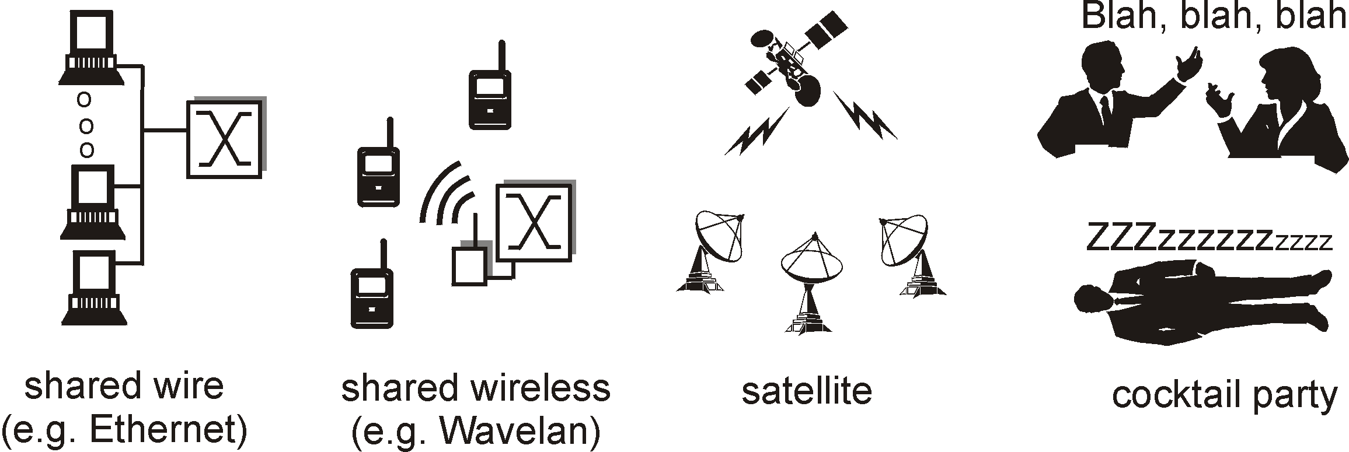

Example Multiple Access Links
Shared acoustical waves
(Humans at a party)
Shared RF
(e.g., 802.11 WiFi)
Shared RF (satellite)
Shared wire
(e.g., cabled Ethernet)

Slide 5
Different approaches to MAC
1- Channel Partitioning
Divide channel into smaller “pieces” (time slots, frequency, code) and allocate for exclusive use
2- Random-access
Channel not divided, allow (and recover from) collisions
3- Round-robin or “taking turns”
Nodes use tokens to share the media deterministically; for bursty data traffic, performs better than channel partitioning
Notes:
Example of sharing the media through channel partitioning is FDM/ TDM and CDMA. They allocated fixed slots/ frequencies/ codes to users and therefore are fair. By ‘fair’ it means that a single user cannot take control of the media depriving others of the right to access it.
Examples of ‘Random Access’ MAC is Aloha, CSMA, CSMA/ CD and CSMA/ CA.
Example of ‘Taking turns’ is Token Ring. Such algorithms are fair in that all users get to access the media after some time (a single node cannot hog all the channel for extended times). It is also deterministic as the time it will take a node to get the token back can be determined a priori.

Slide 6
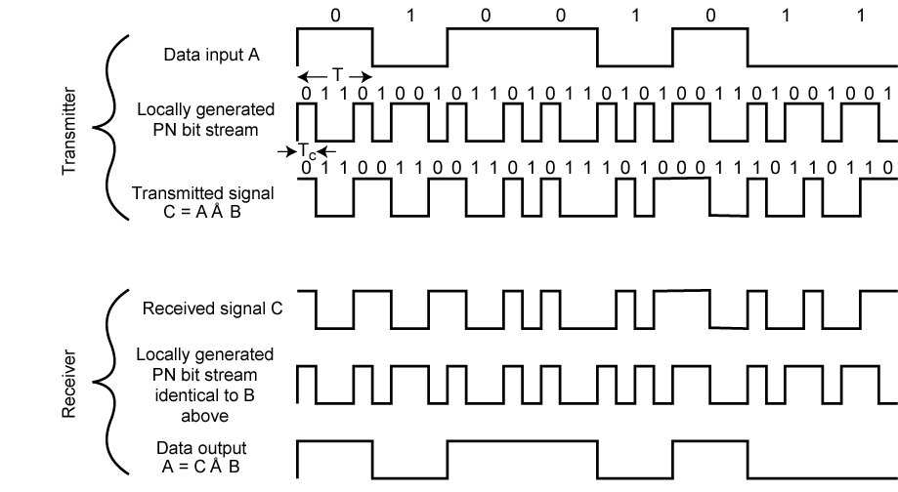
Side note: DSSS
Notes:
Interesting fact: https://rjlipton.wordpress.com/2010/07/25/hedy-lamarr-the-inventor/

Slide 7
Random Access Protocol
Random access MAC protocol specifies:
how to detect collisions
how to recover from collisions
Examples of random access MAC protocols:
ALOHA; CSMA/CD, CSMA/CA

Slide 8
What is Multiple Access?
More than one node trying to transmit data over a shared channel
Characteristics:
If one node wants to transmit → transmits at R bps
If M nodes want to transmit → transmit at R/M bps
Time multiplexed
No one node can bring down the system
Protocol is simple and inexpensive to implement

Slide 9
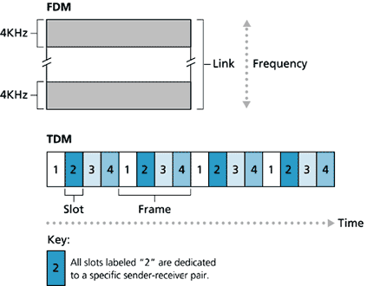
TDM & FDM
R: bitrate
M: transmitting nodes
TDM
A node may only use R/M bps even when no other node wishes to transmit
Can be used for fair or priority based multiplexing
Bandwidth is wasted
Efficient bandwidth allocation techniques are used to minimize wastage

Slide 10
Slotted ALOHA
Simple Multiple Access Protocol
Notes:
Ethernet is the most famous example of LAN technology. Developed in mid-70s at the Xerox Palo Alto Research Center (PARC), the Ethernet is a working example of a more general class of shared access LANs that operate on the Carrier Sense on Multiple Access – Collision Detection technology.
Ethernet is like a bus with multiple stations plugged into it. The ‘carrier sense’ means that all the nodes can distinguish between idle and a busy link, and ‘collision detect’ means that a node listen as it transmits and can therefore detect when a frame it is transmitting has interfered (collided) with a frame transmission by another node.
Ethernet has its root in an early packet radio network called Aloha developed at the University of Hawaii. Like the Aloha network, the fundamental problem in Ethernet is how to mediate access to the shared medium. In Aloha, the medium is atmosphere, and in Ethernet the medium is a coax cable.
Thus the core idea in both Ethernet and Aloha is an algorithm that controls when each node can transmit.
Digital Equipment Corporation, Intel and Xerox defined a 10 Mbps standard in 1978. This standard formed the basis of the Ethernet standard.
Digital Equipment Corporation (DEC) and Intel Corporation joined Xerox to define the initial 10 Mbps Ethernet standard in 1978. This standard then formed the basis for IEEE 802.3 standard.
With one exception (type and length field), the 1978 Ethernet standard can be thought of as a proper subset of the 802.3 standard. 802.3, in addition, defines a much wider collection of physical media over which Ethernet can operate and more recently, it has been extended to include a 100 Mbps standard known as Fast Ethernet, and a 1000 Mbps version known as Gigabit Ethernet.
With the introduction of Gigabit Ethernet, what started as a LAN technology has now had its reach extended to distances that make Ethernet a metropolitan-area and even a wide-area networking standard (since Gigabit Ethernet uses OFC that has a higher range).
In the book, we cover 10 Mbps Ethernet since it is typically used in multi-access mode and we are interested in knowing how multiple hosts share a single link. Both 100 Mbps and 1 Gbps Ethernets are to be used in full duplex, point to point configuration which mean they typically use switched networks.

Slide 11
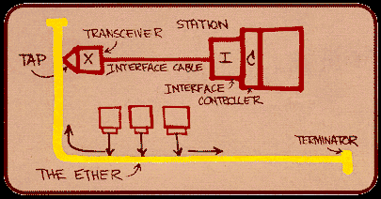
Wired (direct-link) networks
Example: IEEE 802.3 Standard
Ethernet has its root in an early packet radio network called Aloha developed at the University of Hawaii. Like the Aloha network, the fundamental problem in Ethernet is how to mediate access to the shared medium. In Aloha, the medium is atmosphere, and in Ethernet the medium is a coax cable.
Bob Metcalfe’s Original Ethernet Sketch
Notes:
Ethernet is the most famous example of LAN technology. Developed in mid-70s at the Xerox Palo Alto Research Center (PARC), the Ethernet is a working example of a more general class of shared access LANs that operate on the Carrier Sense on Multiple Access – Collision Detection technology.
Ethernet is like a bus with multiple stations plugged into it. Thus the core idea in both Ethernet and Aloha is an algorithm that controls when each node can transmit.
Digital Equipment Corporation, Intel and Xerox defined a 10 Mbps standard in 1978. This standard formed the basis of the Ethernet standard.
Digital Equipment Corporation (DEC) and Intel Corporation joined Xerox to define the initial 10 Mbps Ethernet standard in 1978. This standard then formed the basis for IEEE 802.3 standard.
With one exception (type and length field), the 1978 Ethernet standard can be thought of as a proper subset of the 802.3 standard. 802.3, in addition, defines a much wider collection of physical media over which Ethernet can operate and more recently, it has been extended to include a 100 Mbps standard known as Fast Ethernet, and a 1000 Mbps version known as Gigabit Ethernet.
With the introduction of Gigabit Ethernet, what started as a LAN technology has now had its reach extended to distances that make Ethernet a metropolitan-area and even a wide-area networking standard (since Gigabit Ethernet uses OFC that has a higher range).
In the book, we cover 10 Mbps Ethernet since it is typically used in multi-access mode and we are interested in knowing how multiple hosts share a single link. Both 100 Mbps and 1 Gbps Ethernets are to be used in full duplex, point to point configuration which mean they typically use switched networks.

Slide 12
ALOHA/Slotted ALOHA
Slotted ALOHA succeeded pure ALOHA
Tx at any time in pure ALOHA
Slotted ALOHA
Time slot equal to frame length
Node may only start transmitting at the beginning of a slot
In case of a single node, transmission is successful
Incase of multiple nodes trying to Tx at the same time, collision occurs, nodes try in the next time slot or skip a time slot based on probability
Notes:
https://techdifferences.com/difference-between-pure-aloha-and-slotted-aloha.html

Slide 13
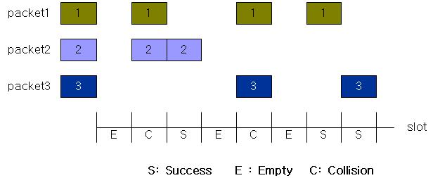
Problems with Slotted ALOHA
High collision rate in case of multiple transmitting nodes
Many Empty slots
Reduced utilization
http://jweh.tistory.com/29

Slide 14
Problems with
ALOHA/S-ALOHA
Node transmits irrespective of whether another node is transmitting
Collision!
If two frames are transmitted simultaneously, they overlap in time and the resulting signal is garbled (mix-up), this event is called collision.
Notes:
The ‘carrier sense’ means that all the nodes can distinguish between idle and a busy link, and ‘collision detect’ means that a node listen as it transmits and can therefore detect when a frame it is transmitting has interfered (collided) with a frame transmission by another node.

Slide 15
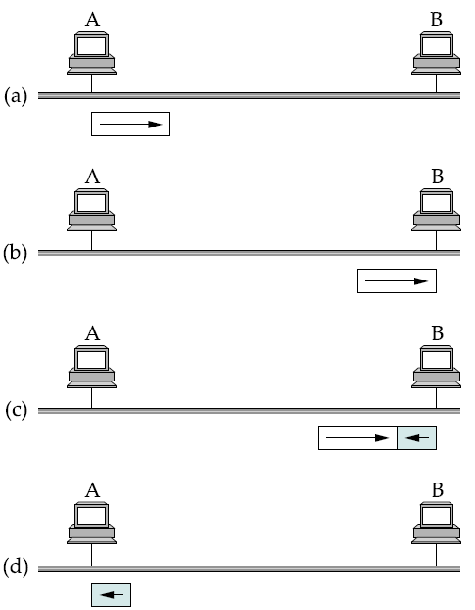
How do collisions occur?
Propagation delay: d
Notes:
Minimum IPv4 frame size = 18 (Ethernet) + 20 (IPv4) + 8 (UDP) + 18 (payload) = 64 bytes

Slide 16
Collisions – worst case scenario
Propagation delay: d
A sends a frame at t
A’s frame arrives at B
at t + d
B sends a frame at t +d causing a collision
B’s runt (32 bit) arrives at A at t+2d
Notes:
The figure above illustrates the worst-case scenario, where hosts A and B are at opposite ends of the network. Suppose host A begins transmitting a frame at time t, as shown in (a). It takes it one link latency (let’s denote the latency as d) for the frame to reach host B. Thus, the first bit of A’s frame arrives at B at time t +d, as shown in (b). Suppose an instant before host A’s frame arrives (i.e., B still sees an idle line), host B begins to transmit its own frame. B’s frame will immediately collide with A’s frame, and this collision will be detected by host B (c). Host B will send the 32-bit jamming sequence, as described above. (B’s frame will be a runt.) Unfortunately, host A will not know that the collision occurred until B’s frame reaches it, which will happen one link latency later, at time t+2×d, as shown in (d). Host A must continue to transmit until this time in order to detect the collision. In other words, host A must transmit for 2×d to be sure that it detects all possible collisions.
Considering that a maximally configured Ethernet is 2500 m long, and that there may be up to four repeaters between any two hosts, the round-trip delay has been determined to be 51.2 μs, which on a 10-Mbps Ethernet corresponds to 512 bits.

Slide 17
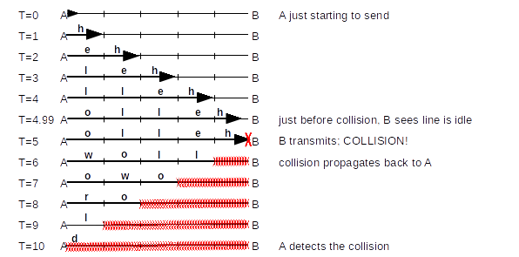
Collisions – worst case scenario
Notes:
http://intronetworks.cs.luc.edu/1/html/ethernet.html

Slide 18
Minimum sized Ethernet frame
Propagation delay: d
An Ethernet station must transmit for at least 2d time to be able to detect a collision
The maximum RTT for 10Base5 is 51.2 us
IEEE 802.3, 5-4-3 rule
2500 meters max length
therefore min frame size at 10Mbps = 512 bits (64 bytes)
Smaller frames padded to comply with min frame size
Notes:
Slot time is a concept in computer networking. It is at least twice the time it takes for an electronic pulse (OSI Layer 1 - Physical) to travel the length of the maximum theoretical distance between two nodes

Slide 19
Carrier Sense on Multiple Access/ Collision Detection (CSMA/ CD)
Human analogy
Do not speak if you find someone else speaking
i.e., do not interrupt
Notes:
Ethernet is the most famous example of LAN technology. Developed in mid-70s at the Xerox Palo Alto Research Center (PARC), the Ethernet is a working example of a more general class of shared access LANs that operate on the Carrier Sense on Multiple Access – Collision Detection technology.
Ethernet is like a bus with multiple stations plugged into it. The ‘carrier sense’ means that all the nodes can distinguish between idle and a busy link, and ‘collision detect’ means that a node listen as it transmits and can therefore detect when a frame it is transmitting has interfered (collided) with a frame transmission by another node.
Ethernet has its root in an early packet radio network called Aloha developed at the University of Hawaii. Like the Aloha network, the fundamental problem in Ethernet is how to mediate access to the shared medium. In Aloha, the medium is atmosphere, and in Ethernet the medium is a coax cable.
Thus the core idea in both Ethernet and Aloha is an algorithm that controls when each node can transmit.
Digital Equipment Corporation, Intel and Xerox defined a 10 Mbps standard in 1978. This standard formed the basis of the Ethernet standard.
Digital Equipment Corporation (DEC) and Intel Corporation joined Xerox to define the initial 10 Mbps Ethernet standard in 1978. This standard then formed the basis for IEEE 802.3 standard.
With one exception (type and length field), the 1978 Ethernet standard can be thought of as a proper subset of the 802.3 standard. 802.3, in addition, defines a much wider collection of physical media over which Ethernet can operate and more recently, it has been extended to include a 100 Mbps standard known as Fast Ethernet, and a 1000 Mbps version known as Gigabit Ethernet.
With the introduction of Gigabit Ethernet, what started as a LAN technology has now had its reach extended to distances that make Ethernet a metropolitan-area and even a wide-area networking standard (since Gigabit Ethernet uses OFC that has a higher range).
In the book, we cover 10 Mbps Ethernet since it is typically used in multi-access mode and we are interested in knowing how multiple hosts share a single link. Both 100 Mbps and 1 Gbps Ethernets are to be used in full duplex, point to point configuration which mean they typically use switched networks.

Slide 20
CSMA/CD
The ‘carrier sense’ means that all the nodes can distinguish between idle and a busy link, and ‘collision detect’ means that a node listen as it transmits and can therefore detect when a frame it is transmitting has interfered (collided) with a frame transmission by another node.
Notes:
The ‘carrier sense’ means that all the nodes can distinguish between idle and a busy link, and ‘collision detect’ means that a node listen as it transmits and can therefore detect when a frame it is transmitting has interfered (collided) with a frame transmission by another node.

Slide 21
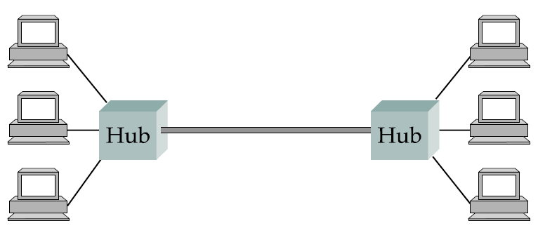
Ethernet Hub
Sidenote
Single collision domain
Notes:
It is important to understand that whether a given Ethernet spans a single segment, a linear sequence of segments connected by repeaters, or multiple segments connected in a star configuration by a hub, data transmitted by any one host on that Ethernet reaches all the other hosts. This is the good news. The bad news is that all these hosts are competing for access to the same link, and as a consequence, they are said to be in the same collision domain.

Slide 22
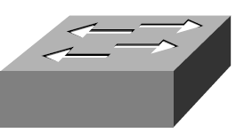
Ethernet Switch
Sidenote
Collision domain
Collision domain
Bridge/ Switch

Slide 23
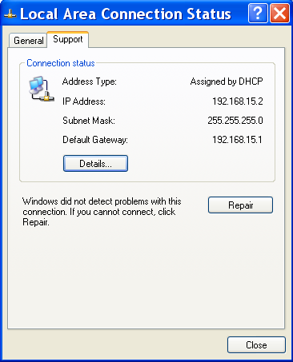
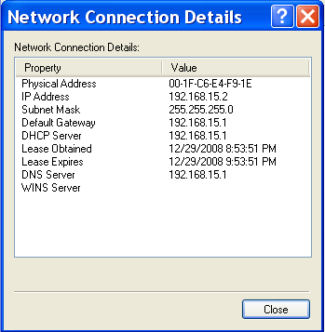
Receiver CSMA/ CD Algorithm
An Ethernet NIC receives all frames but accepts:
Frames addressed to its own address
Frames addressed to the broadcast address
Frames addressed to a multicast address, if instructed to listen to that address
All frames, if placed in promiscuous mode

Slide 24
Transmitter CSMA/CD Algorithm
If NIC senses channel idle, starts transmission
If NIC senses channel busy, waits until channel idle, then transmits
If NIC transmits entire frame detecting no other transmission, NIC is done with frame (transmission successful)
Notes:
https://www.cs.unc.edu/~sandrabi/Project_work/Capture-Effect_Report.pdf

Slide 25
Transmit Algorithm: CSMA/ CD
If NIC detects another transmission while transmitting, aborts and sends jam signal
After aborting, NIC enters exponential backoff: after m^{th} collision, k is chosen randomly from {0,1,2,…,2^{m}-1}. NIC waits k·512 bit times, returns to Step 1.
Slot time
Notes:
Switched Ethernet
Switches join separate physical Ethernets (or Ethernets and token rings). A switch has two or more Ethernet interfaces; when a packet is received on one interface it is retransmitted on one or more other interfaces. Only valid packets are forwarded; collisions are not propagated. The term collision domain is sometimes used to describe the region of an Ethernet in between switches; a given collision propagates only within its collision domain. All the collision-detection rules, including the rules for maximum network diameter, apply only to collision domains, and not to the larger “virtual Ethernets” created by stringing collision domains together with switches.

Slide 26
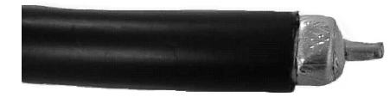
Thicknet – 10Base5
Attachment Unit Interface (AUI) cable
Ethernet Adapter or, Controller
Terminator
Vampire Tap
Transceiver or MAU
Ethernet Bus
Segment length < 500m
Early standard for Ethernet implementation
5-4-3 rule applies
No more than 100 computers, bus topology
Can be used together with 10Base2 for scalability
Proper termination at either ends is essential to mitigate signal bouncing
Notes:
An Ethernet segment is implemented on a coaxial cable of up to 500 m. This cable is similar to the type used for cable TV, except that it typically has an impedance of 50 ohms instead of cable TV’s 75 ohms. Hosts connect to an Ethernet segment by tapping into it; taps must be at least 2.5 m apart. A transceiver—a small device directly attached to the tap—detects when the line is idle and drives the signal when the host is transmitting. It also receives incoming signals. The transceiver is, in turn, connected to an Ethernet adaptor, which is plugged into the host. All the logic that makes up the Ethernet protocol, as described in this section, is implemented in the adaptor (not the transceiver).
Vampire Tap is also called a Media Access Unit (MAU) and it’s called a Vampire Tap since it connects to the cable by simply puncturing the cable with a sharp prong that extends into the cable until it makes contact with the central conductor (From: Tomasi’s book)
5 - the number of network segments
4 - the number of repeaters needed to join the segments into one collision domain
3 - the number of network segments that have active (transmitting) devices attached
2 - the number of segments that do not have active devices attached
1 - the number of collision domains
The rule was created in the early days of the Ethernet when 10Base5 and 10Base2 were the only Ethernet types available, and shared access backbones were quite slow. The 5-4-3 rule was designed to minimize signal transmission time.

Slide 27
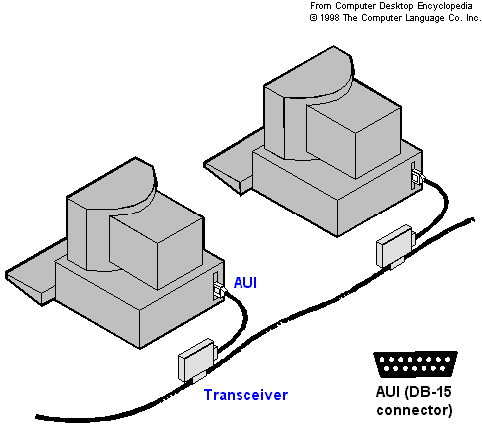
Thicknet – 10Base5
Notes:
Source: http://i.technet.microsoft.com/Cc723461.net6(en-us,TechNet.10).gif
A transceiver designed for thicknet Ethernet includes a connector known as a vampire tap or a piercing tap to make the actual physical connection to thicknet core. This connector is pierced through the insulating layer and makes direct contact with the conducting core. Connection from the transceiver to the network adapter card is made using a transceiver cable (drop cable) to connect to the attachment unit interface (AUI) port connector on the card. An AUI port connector for thicknet is also known as a Digital Intel Xerox (DIX) connector after the three companies that developed it and its related standards, or as a DB (D-sub)-15 connector.

Slide 28
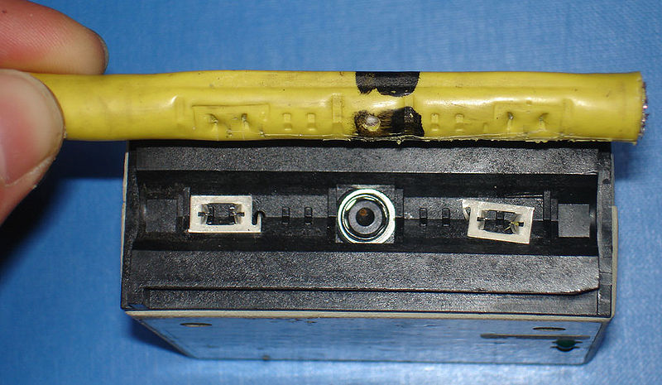
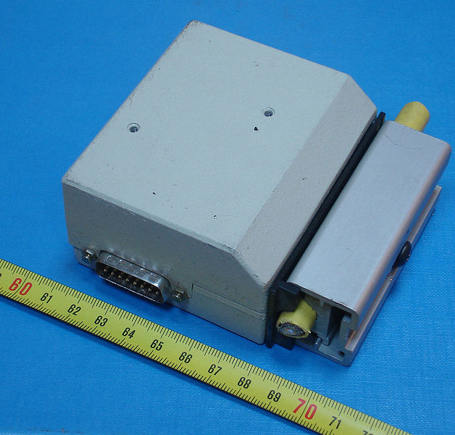
Thicknet (10Base5)
Transceiver or Medium Attachment Unit (MAU)
Earlier way of tapping a Thicknet 10Base5 cable
Modern cable standards such as Cat5 connect directly to Hubs
Source: Wikimedia Commons
Notes:
http://en.wikipedia.org/wiki/File:ThicknetTransceiver.jpg

Slide 29
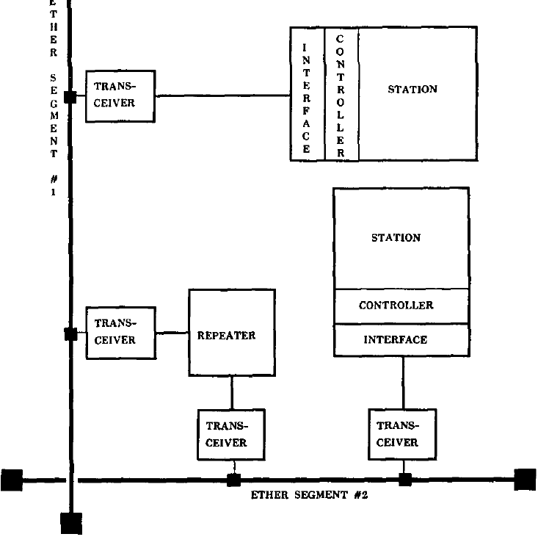
Ethernet Repeater
Sidenote
Ether segment #1
Ether segment #2
Figure adapted from: “Ethernet: distributed packet switching for local computer networks” by Metcalfe and Boggs
Notes:
Multiple Ethernet segments can be joined together by repeaters. A repeater is a device that forwards digital signals, much like an amplifier forwards analog signals. However, no more than four repeaters may be positioned between any pair of hosts, meaning that an Ethernet has a total reach of only 2500 m.
An Ethernet is limited to supporting a maximum of 1024 hosts
Any signal placed on the Ethernet by a host is broadcast over the entire network; that is, the signal is propagated in both directions, and repeaters forward the signal on all outgoing segments. Terminators attached to the end of each segment absorb the signal and keep it from bouncing back and interfering with trailing signals.

Slide 30
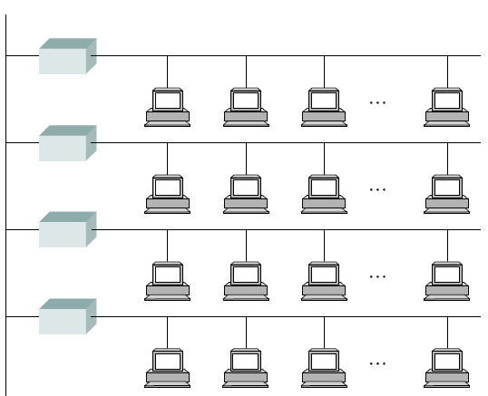
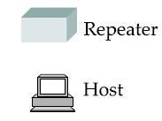
Ethernet Repeater
Sidenote
Max Segment length: 500 m
Notes:
Multiple Ethernet segments can be joined together by repeaters. A repeater is a device that forwards digital signals, much like an amplifier forwards analog signals. However, no more than four repeaters may be positioned between any pair of hosts, meaning that an Ethernet has a total reach of only 2500 m.
An Ethernet is limited to supporting a maximum of 1024 hosts
Any signal placed on the Ethernet by a host is broadcast over the entire network; that is, the signal is propagated in both directions, and repeaters forward the signal on all outgoing segments. Terminators attached to the end of each segment absorb the signal and keep it from bouncing back and interfering with trailing signals.

Slide 31

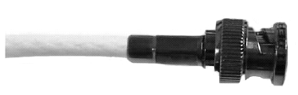
Thinnet – 10Base2
Terminator
Transceiver
Controller
Ethernet Bus
BNC T-Junction
5-4-3 rule applies
No more than 30 computers wired to a segment
Bus topology
Drawbacks
Single point of failure
Low bandwidth
Segment length < 200m
Notes:
In addition to the system of segments and repeaters just described, alternative technologies have been introduced over the years. For example, rather than using a 50-ohm coax cable, an Ethernet can be constructed from a thinner cable known as 10Base2; the original cable is called 10Base5 (the two cables are commonly called thin-net and thick-net, respectively). The “10” in 10Base2 means that the network operates at 10 Mbps, “Base” refers to the fact that the cable is used in a baseband system, and the “2” means that a given segment can be no longer than 200 m (a segment of the original 10Base5 cable can be up to 500 m long).
Because the cable is so thin, you do not tap into a 10Base2 or 10BaseT cable in the same way as you would with 10Base5 cable. With 10Base2, a T-joint is spliced into the cable. In effect, 10Base2 is used to daisy-chain a set of hosts together.

Slide 32
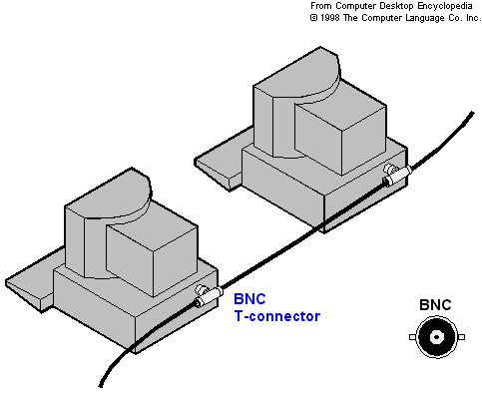
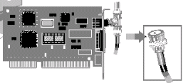
Thinnet (10Base2)
Figure modified from: http://technet.microsoft.com/en-us/library/cc723461.aspx
Notes:
Following text from: http://technet.microsoft.com/en-us/library/cc723461.aspx
Thinnet is a flexible coaxial cable about .25 inch thick. Because this type of coaxial is flexible and easy to work with, it can be used in almost any type of network installation. Networks that use thinnet have the cable connected directly to a computer's network adapter card.

Slide 33
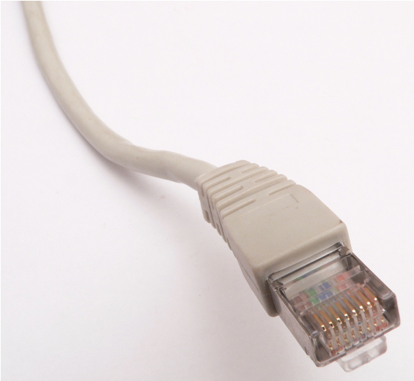
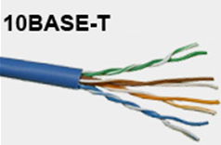
Twisted Pair – 10BaseT
Controller
Uses UTP Cabling
Uses HUBs to connect devices on the network
Effective bandwidth of 4 to 6 Mbps
Star topology using hubs
Cat-3/Cat-4/Cat-5/Cat-5e cables terminated w/ RJ-45 connectors
1024 nodes supported
Multi-port repeater or Hub
Segment length < 100m
Notes:
Today, a third cable technology is predominantly used, called 10BaseT, where the “T” stands for twisted pair. Typically, Category 5 twisted pair wiring is used. A 10BaseT segment is usually limited to under 100 m in length. (Both 100-Mbps and 1000-Mbps Ethernets also run over Category 5 twisted pair, up to distances of 100 m.)
With 10BaseT, the common configuration is to have several point-to-point segments coming out of a multi-way repeater, sometimes called a hub, as illustrated in Figure 2.26. Multiple 100-Mbps Ethernet segments can also be connected by a hub, but the same is not true of 1000-Mbps segments.

Slide 34
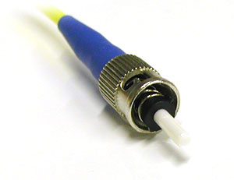
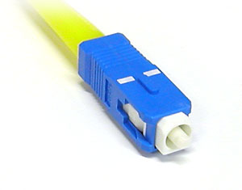
100BaseFX
Fast Ethernet using Multimode Optical Fiber Cable
62.5(core)/125(cladding) micron diameter
1300nm wavelength using two optical fiber cables (one each for Tx and Rx)
Mostly used within small premises
Advantages
Immune from EMI
Light weight
Low Loss
Increased security
Easy/inexpensive coupling of light using LED
Disadvantages
Modal dispersion
Chromatic Dispersion
Single Mode Optical Fiber Cable?
ST Connector
SC Connector
Push/pull, easy install
Segment length < 2km
Notes:
Today, a third cable technology is predominantly used, called 10BaseT, where the “T” stands for twisted pair. Typically, Category 5 twisted pair wiring is used. A 10BaseT segment is usually limited to under 100 m in length. (Both 100-Mbps and 1000-Mbps Ethernets also run over Category 5 twisted pair, up to distances of 100 m.)
With 10BaseT, the common configuration is to have several point-to-point segments coming out of a multi-way repeater, sometimes called a hub, as illustrated in Figure 2.26. Multiple 100-Mbps Ethernet segments can also be connected by a hub, but the same is not true of 1000-Mbps segments.
Single Mode fiber optic cable has a small diametral core that allows only one mode of light to propagate. Because of this, the number of light reflections created as the light passes through the core decreases, lowering attenuation and creating the ability for the signal to travel further. This application is typically used in long distance, higher bandwidth runs by Telcos, CATV companies, and Colleges and Universities.
Modal dispersion is a distortion mechanism occurring in multimode fibers and other waveguides, in which the signal is spread in time because the propagation velocity of the optical signal is not the same for all modes.
Chromatic dispersion is a phenomenon that is an important factor in fiber optic communications. It is the result of the different colors, or wavelengths, in a light beam arriving at their destination at slightly different times.

Slide 35
Exercise
Connect the following with
10Base5; 10Base2 and 10BaseT
office 1
office 2
office 3
office 4
office 5
office 6
office 7
office 8
Figure adapted from: Douglas Comer: “Computer Networks and Internets”
Notes:
Networks of any size can be built using the two building blocks: links and nodes

Slide 36
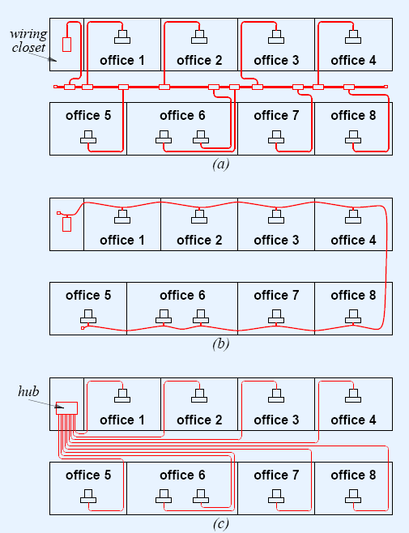
Exercise
10Base5
10Base2
10Base2
Figure adapted from:
Douglas Comer: “Computer Networks and Internets”
10BaseT
Notes:
Networks of any size can be built using the two building blocks: links and nodes

Slide 37
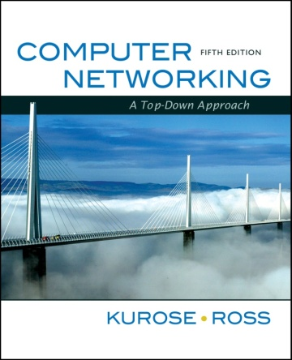
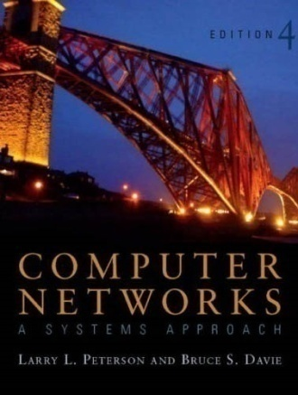
References
Sections 5.1, 5.3, 5.5
The Link Layer and Local Area Networks [K&R]
Section 2.6:
Direct link Networks [P&D]

Slide 38
[ End of lecture ]
Images are copyrights of their respective owners
Some material in this lecture is taken from:
Dr Junaid Qadir, NUST-SEECS

